Slide 1
Malignant comments Classifier

Slide 2
1
Introduction
2
Problem statement
CONTENTS
3
Understanding of Dataset
4
Tools used

Slide 3
5
Data Preparation
6
Data Preprocessing
CONTENTS
7
Visualization
8
Model building

Slide 4
1
Introduction

Slide 5
Introduction
The proliferation of social media enables people to express their opinions widely online. However, at the same time, this has resulted in the emergence of conflict and hate, making online environments uninviting for users. Although researchers have found that hate is a problem across multiple platforms, there is a lack of models for online hate detection.
Online hate, described as abusive language, aggression, cyberbullying, hatefulness and many others has been identified as a major threat on online social media platforms. Social media platforms are the most prominent grounds for such toxic behavior.
Our goal is to build a prototype of online hate and abuse comment classifier which can used to classify hate and offensive comments so that it can be controlled and restricted from spreading hatred and cyberbullying.

Slide 6
2
Problem Statement

Slide 7
Problem Statement
Our problem statement is to build a prototype of online hate and abuse comment classifier which can used to classify hate and offensive comments so that it can be controlled and restricted from spreading hatred and cyberbullying.

Slide 8
3
Understanding Data

Slide 9
Understanding dataset
Data contains 159571 entries each having 8 variables,id,Comment text,Malignant,Highly Malignant,Rude,Abuse,Loathe,threat
Data contains No Null values
We are using wordcloud to analyze the possibility of negetive,positive as well has neutral sentiments
Data has to be cleaned first for unneccesary spaces,punctuations,repeating words by using stop words,lemmatization,stemming.

Slide 10
4
Tools used

Slide 11
Tools used
Tools Used
Python(Jupyter)
Numpy
Pandas
Sklearn
Matplotlib
Seaborn
Classification Models
Ensembling Technique
GridSearch CV(HyperParaMeter Tuning)

Slide 12
5
Data Preparation

Slide 13
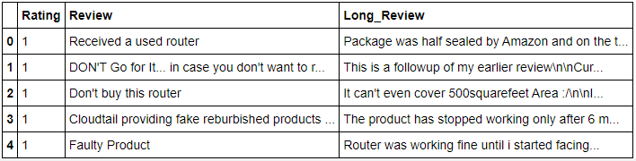
Data Preparation
With the help of Pandas Library We will upload our data to Jupyter Notebook.
Once our data is uploaded with the help of predefined method (i.e. read_csv) we can read data for further processing.
We have two type of variables in the data:-
Dependent Variable
Independent Variable

Slide 14
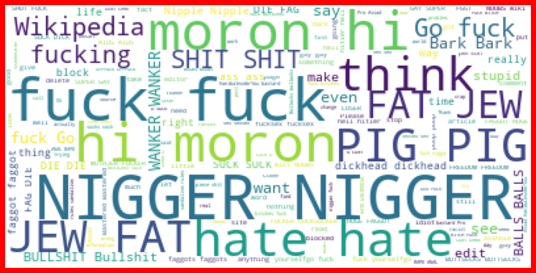
Malignant

Slide 15
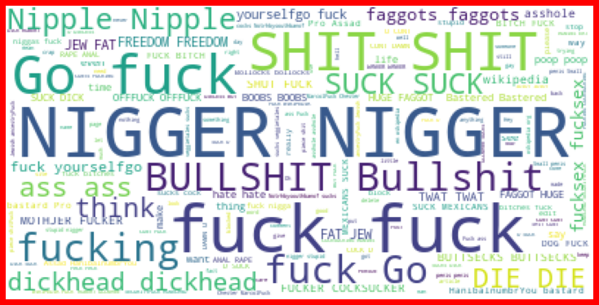
Rude

Slide 16
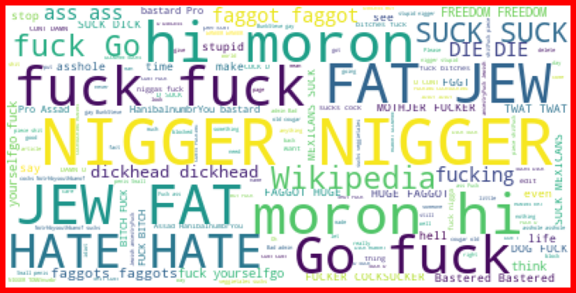
Abuse

Slide 17
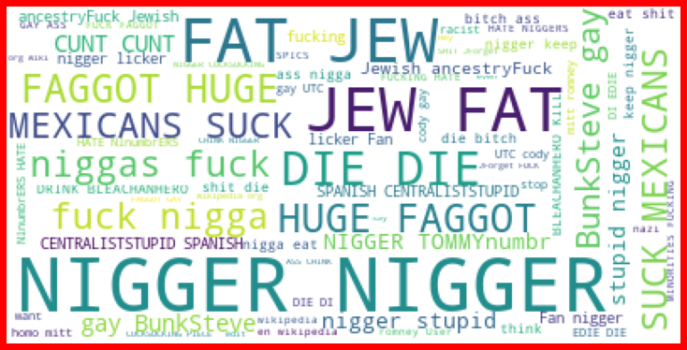
Loathe

Slide 18
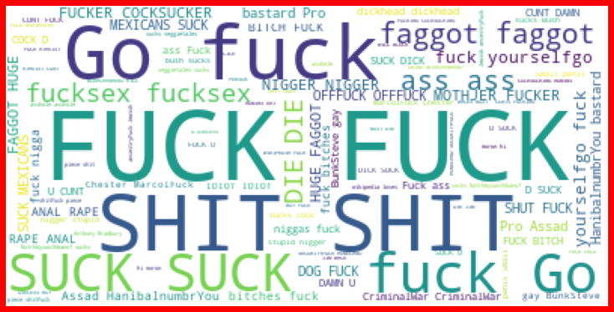
Highly malignant

Slide 19
6
Visualization

Slide 20
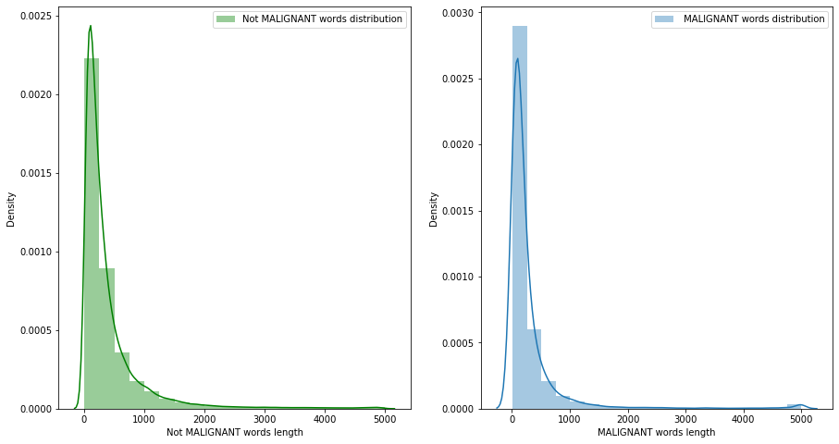
Non Malignant and Malignant comments with original comments
Visualization

Slide 21
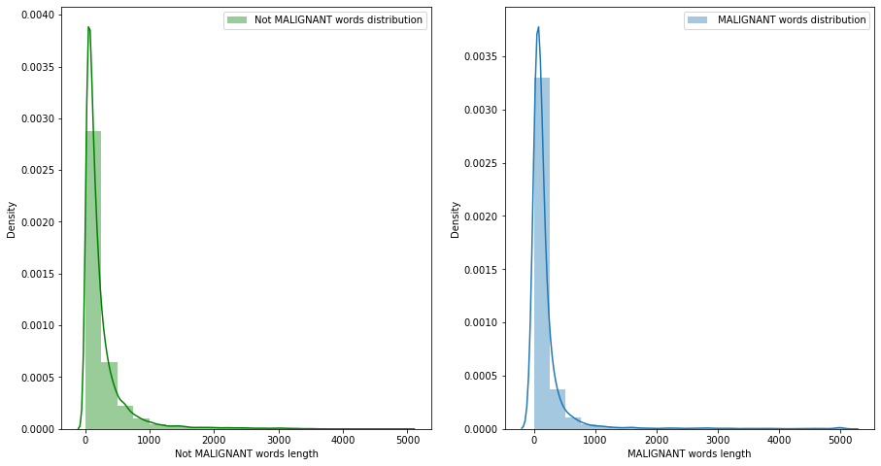
Non Malignant and Malignant comments with filtered comments
Visualization

Slide 22
7
Data Preprocessing

Slide 23
Data Preprocessing
The dataframe is designed to have both train set and test data set
There is no null value present in the dataset and almost all the columns type is objective so we don’t need to check for outliers.
Once our data is ready, we’ll do further processing.
I have dropped only one column i.e. ID because it’s not useful for prediction.

Slide 24

Data Preprocessing
Evaluation Matrices:
Accuracy - it determines how often a model predicts default and non default correctly.
Precision-it calculates whenever our models predicts it is default how often it is correct.
Recall- Recall regulate the actual default that the model is actually predict.
Precision Recall Curve - PRC will display the tradeoff between Precision and Recall threshold.
Cross Validations:
K Fold cross validations , K = 5

Slide 25
8
Model Building

Slide 26
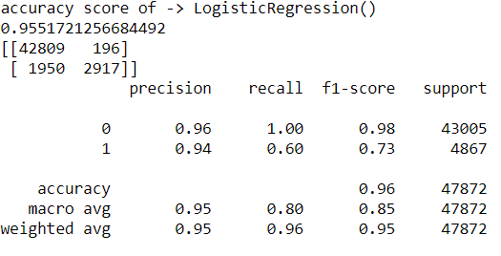
Model Building- Logistic Regression

Slide 27
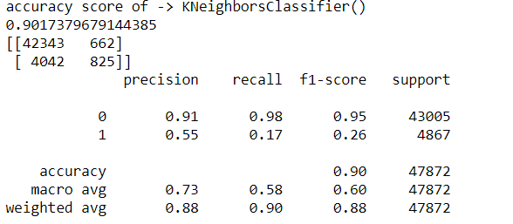
Model building- K nearest neighbor classifier

Slide 28
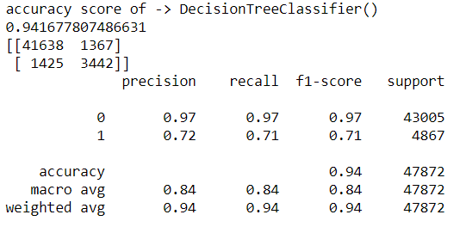
Model building- Decision Tree Classifier

Slide 29
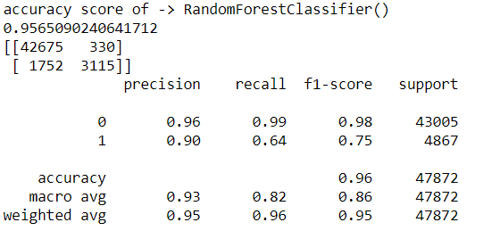
Model building- Random Forest Classifier

Slide 30
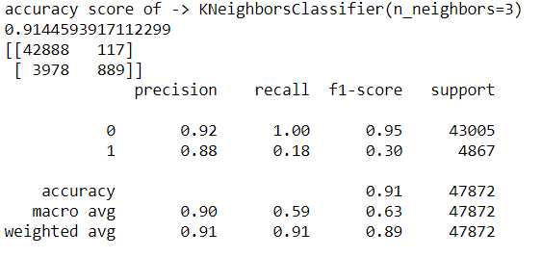
Model building- K neibours classifier with (n_neighbours =3)

Slide 31
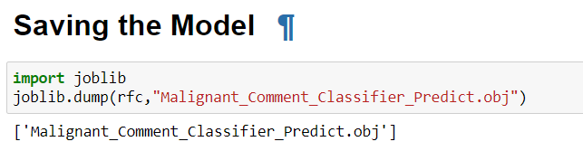
Validating the model
From the details on the above solutions it is clearly understandable that we are getting best result with the help of Random Forest Classifier, so we save this model with the help of joblib Library.

Slide 32
Conclusion
As we know data is increasing in every second in our day today life. So more the data better the model.
Here we saw that harmful or toxic comments in the social media space have many negative impacts to society.
The ability to readily and accurately identify comments as toxic could provide many benefits while mitigating the harm.
we have seen the capability of readily available algorithms to be employed in such a way to address this challenge.
In our specific study, it was demonstrated that an Random Forest Classifier solution provides substantial improvement in classification versus any other algorithm.

Slide 33
Thanks！

